Slide 1
Probabilistic In-Plane Detection for Mid-Air Virtual Surface—Experiment Session
Zhuorui Yu
Supervisor: Dr. John Dudley
Department of Engineering

Slide 2
Introduction
You will be instructed to conduct a series of Planar Interaction Tasks using a VR headset.
This study aims to test a method designed to prevent unintended drops when interacting with virtual surfaces.
The whole experiment will take about 1 hour.
You will be asked to fill in some questionnaires and take part in a short interview.
Source:https://www.youtube.com/watch?v=qfONlUCSWdg&t=87s
https://www.youtube.com/watch?v=G0eKzU_fV00
Notes:
In physical world we have a lot of planar interaction, you draw, tap on key boards, you change the volume of music on your computer using a slider. With the rapid advancement of AR and VR technologies, we're seeing an expanding market and emergence of powerful hardware, we are now able to transform the physical planar interaction into virtual world. Where sensor….

Slide 3
Planar Interaction Tasks
Drage and drop – imagine you are moving files between folders
Slider setting – image you want to set a specific value on a slider
Sketching – you are drawing a 2D sketch with your fingertip

Slide 4
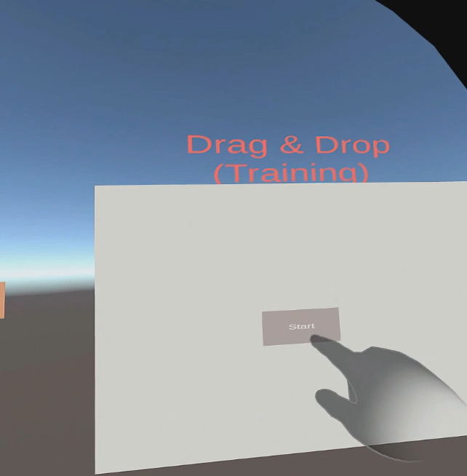
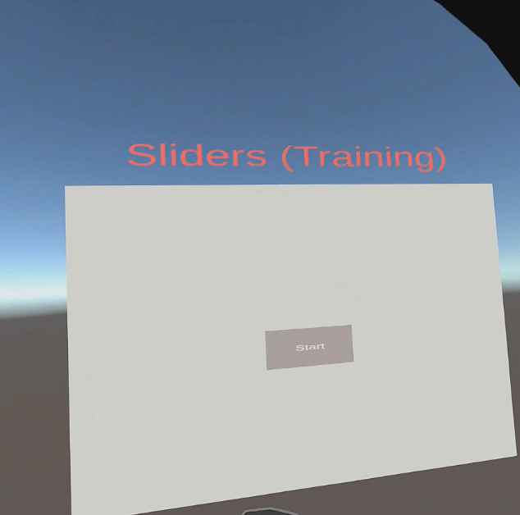
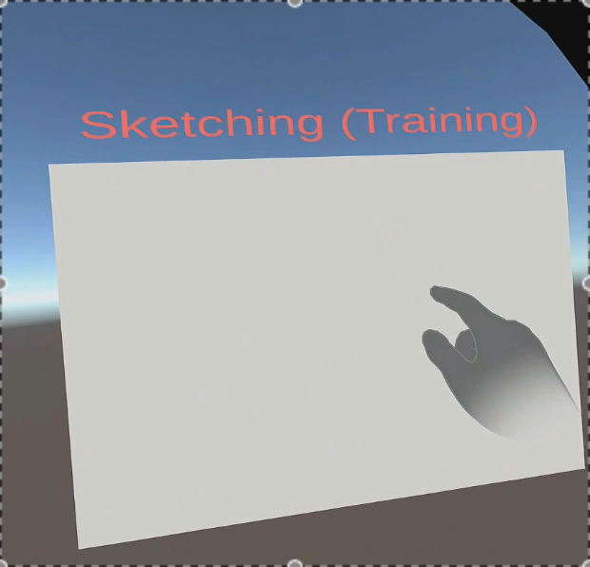
Task Demonstration
Drag & Drop Task
Dragging a cube to different target position
Slider Task
Sliding to different target values
Sketch Task
Drawing smiling face

Slide 5
Planar Interaction Tasks –Drang and Drop
Imagine you are moving files between folders
Settings
35 times in 1 set
2 sets

Slide 6
Planar Interaction Tasks –Slider
Imagine you want to set a specific value on a slider
Settings
Side 3 sliders for 5 times in 1 set
2 sets

Slide 7
Planar Interaction Tasks –Sketching
Imagine you are drawing a 2D sketch with your fingertip
Settings
6 faces in 1 set
2 sets

Slide 8
Experiment Settings
Drag-and-Drop task
35 times in 1 set
2 sets
Slider task
Side 3 sliders for 5 times in 1 set
2 sets
Sketch task
6 faces in 1 set
2 sets

Slide 9
Procedure
Complete the three planar interaction tasks
Fill in the System Usability Survey – how usable the system is
Fill in the NASA-TLX questionnaire – how much workload was involved
Repeat steps 1-3 in the alternative condition
Short interview

